Slide 1

MOVIE RECOMMENDATION SYSTEM
TEAM 01
Distributed and Scalable Data Engineering

Slide 2




MEET OUR TEAM
Cheppela Sai Bhargava
Vishnupriya Doddapaneni
Selinam Setranah
Karthik Nagaboina
Data Scientist
Data Analyst
Data Scientist
Data Engineer

Slide 3
INTRODUCTION
A recommender system is a straightforward algorithm whose goal is to find patterns in a dataset and present the user with the most pertinent information.
Content-based and collaborative filtering recommender systems are the most popular varieties of recommendation systems.
IMDB dataset was used in this study. It contains details on 5000 movies.

Slide 4
Problem & objectives
To create a movie recommendation system that offers customers movie suggestions.
Gather and analyze information.
Create a user-friendly interface.
To ensure the efficiency of the system.

Slide 5
methodology
Business understanding
Data understanding
Data preparation
Modelling
Evaluation
Deployment

Slide 6
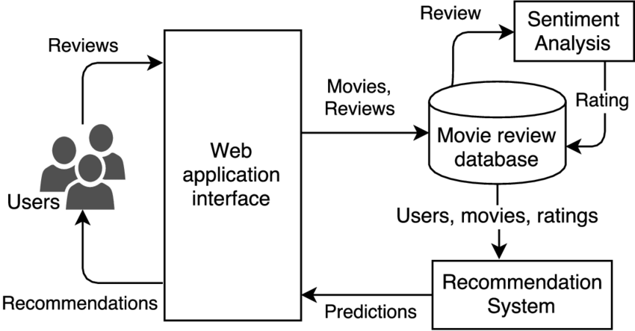
SYSTEM ARCHITECTURE

Slide 7
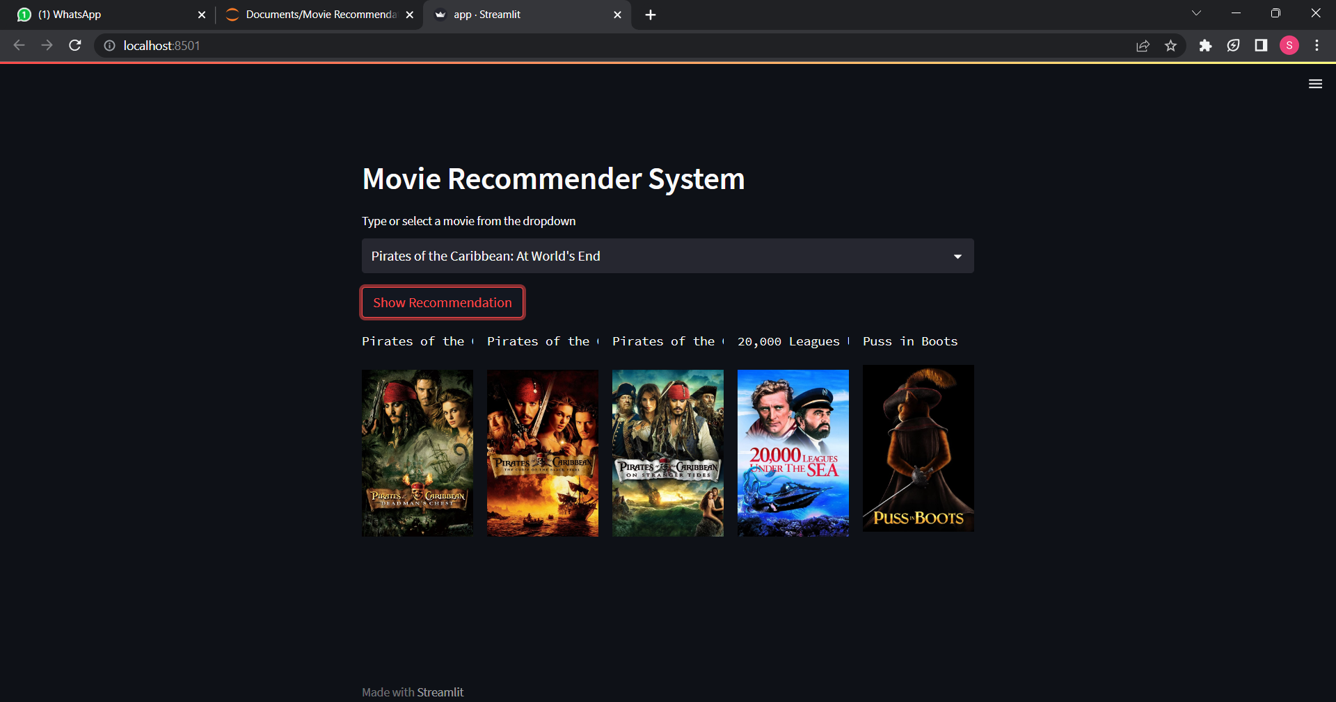
RESULTS

Slide 8
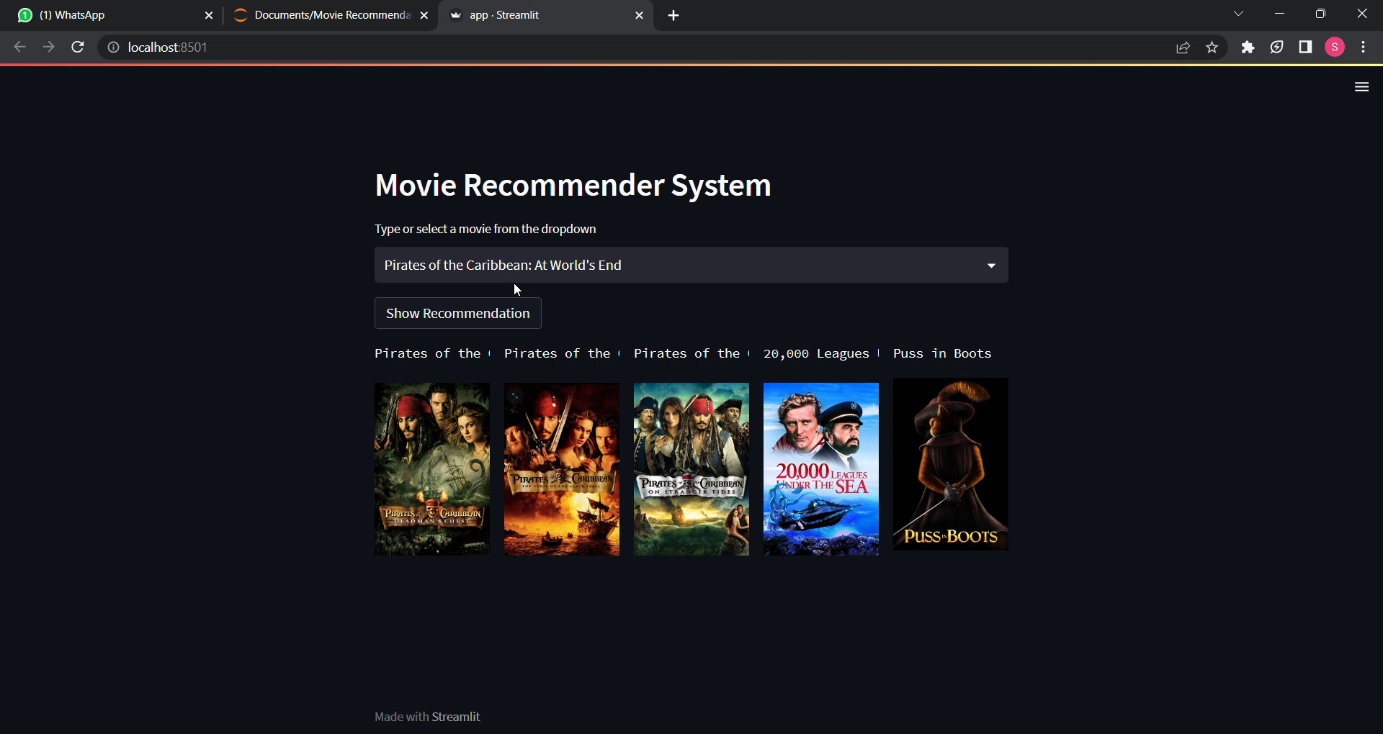
PROJECT VIDEO

Slide 9
FUTURE IMPROVEMENT
Scaling up resources will allow more people to use the website.
Implement the system variation (complex model for recommendation).
Adding reviews to upcoming movies.
Adding short videos about movies.
Improving the overall security of the project will allow it to be used commercially.
Adding weekly trending. Best of all time section and more.

Slide 10
CONCLUSION
The attempt to develop a movie recommendation system is a useful use of machine learning techniques. We have created a system that can provide users tailored and pertinent movie suggestions by gathering data on movies and users, choosing the best algorithms to design the system, and assessing the correctness of recommendations.

Slide 11
THANK YOU

